Slide 1
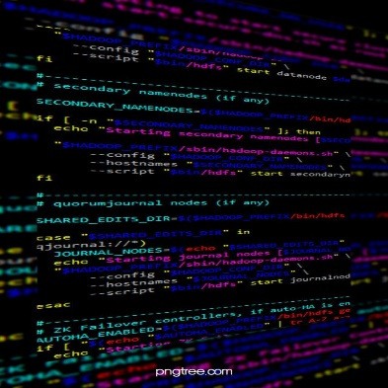

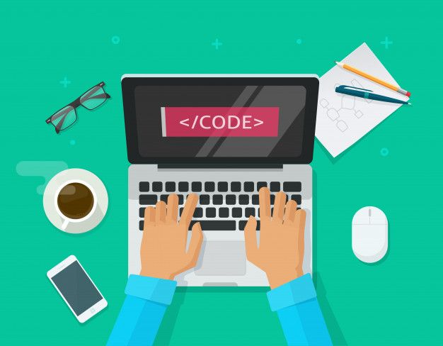

By~ Ruzal Kathiriya
Let’s Learn about,
Kotlin . . .

Slide 2
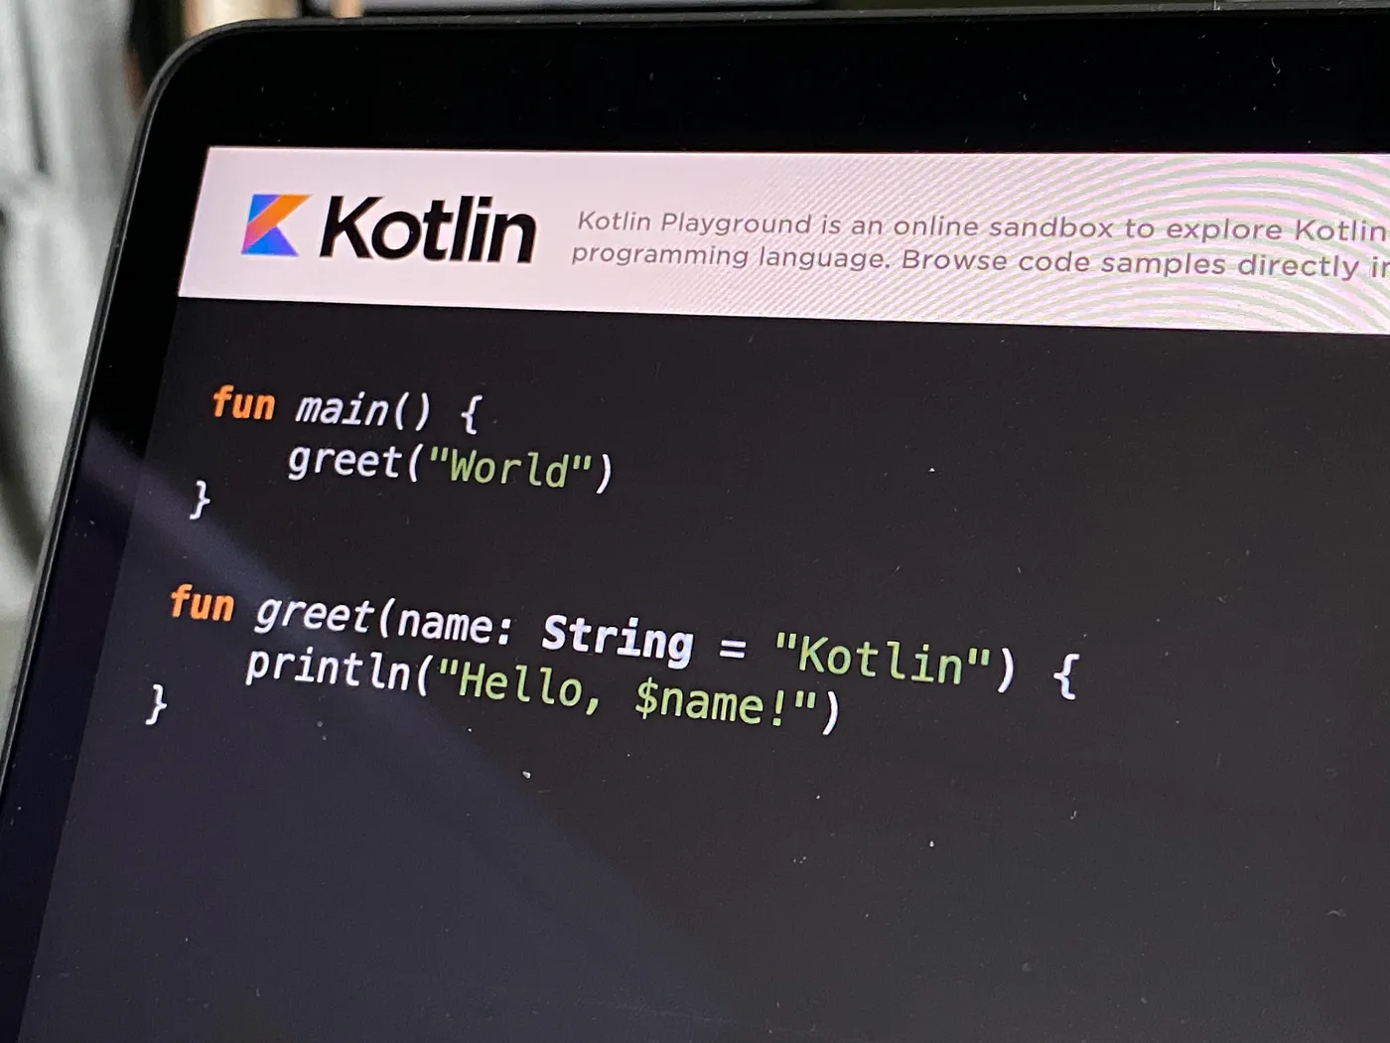
What is Kotlin ?
Kotlin is a statically typed, general-purpose programming language developed by JetBrains, that has built world-class IDEs like IntelliJ IDEA, PhpStorm, Appcode, etc.
It was first introduced by JetBrains in 2011 and is a new language for the JVM.
Kotlin is an object-oriented language, and a “better language” than Java, but still be fully interoperable with Java code.
Kotlin is sponsored by Google, announced as one of the official languages for Android Development in 2017.
Kotlin offers object-oriented and functional features to developers. In contrast, Java only offers object-oriented programming.
Notes:
When conducting research, it is easy to go to one source: Wikipedia. However, you need to include a variety of sources in your research. Consider the following sources:
Who can I interview to get more information on the topic?
Is the topic current and will it be relevant to my audience?
What articles, blogs, and magazines may have something related to my topic?
Is there a YouTube video on the topic? If so, what is it about?
What images can I find related to the topic?

Slide 3
Features Kotlin ?
Conciseness : Kotlin is a concise language, meaning that you can write less code to achieve the same results as in other languages.
Null safety: Kotlin is a null-safe language, meaning that it helps you to avoid NullPointerExceptions. This is done through features such as non-nullable types, nullable types with default values, and the Elvis operator.
Expressiveness: Kotlin is an expressive language, meaning that it allows you to write code that is easy to read and understand.
Interoperability with Java:Kotlin is fully interoperable with Java, meaning that you can use Kotlin code in Java projects and vice versa.
Community: Kotlin has a large and active community, which provides support and resources for Kotlin developers.
Notes:
When conducting research, it is easy to go to one source: Wikipedia. However, you need to include a variety of sources in your research. Consider the following sources:
Who can I interview to get more information on the topic?
Is the topic current and will it be relevant to my audience?
What articles, blogs, and magazines may have something related to my topic?
Is there a YouTube video on the topic? If so, what is it about?
What images can I find related to the topic?

Slide 4
Datatype in Kotlin ?
A data type is a collection of data values that specifies the type of value a variable has and the types of operations that can be performed on it without causing an error. Data types can also represent values as machine types.
Data types are divided into different groups like as below..
(Numbers [Integer, Float], Booleans, Characters, Strings, Arrays)
Numbers Datatype :
(int => These data types contain integer
values.)
(float => These data type used to store
decimal value or fractional part.)
Data Type | Bits | Min Value | Max Value
byte | 8 bits | -128 | 127
short | 16 bits | -32768 | 32767
int | 32 bits | -2147483648 | 2147483647
long | 64 bits | -9223372036854775808 | 9223372036854775807
float | 32 bits | 1.40129846432481707e-45 | 3.40282346638528860e+38
double | 64 bits | 4.94065645841246544e-324 | 1.79769313486231570e+308
Notes:
When conducting research, it is easy to go to one source: Wikipedia. However, you need to include a variety of sources in your research. Consider the following sources:
Who can I interview to get more information on the topic?
Is the topic current and will it be relevant to my audience?
What articles, blogs, and magazines may have something related to my topic?
Is there a YouTube video on the topic? If so, what is it about?
What images can I find related to the topic?

Slide 5
2) Boolean Data type :
Boolean data type represents only one bit of information either true or false. The Boolean type in Kotlin is the same as in Java. These operations disjunction (||) or conjunction (&&) can be performed on boolean types.
3) Character Data Type :
Character data type represents the small letters(a-z), Capital letters(A-Z), digits(0-9) and other symbols.
4) String Data Type :
Strings are used for storing text. A string contains a collection of characters surrounded by double quotes.
Data Type | Bits | Data Range
boolean | 1 bit | true or false
Data Type | Bits | Min Value | Max Value
char | 16 bits | ‘\u0000’ (0) | ‘\uFFFF’ (65535)

Slide 6
Variables in Kotlin ?
every variable should be declared before it’s used. Without declaring a variable, an attempt to use the variable gives a syntax error.
Declaration of the variable type also decides the kind of data you are allowed to store in the memory location. In case of local variables, the type of variable can be inferred from the initialized value.
Example of declare variables :
var rollno = 5
var name = “sita”
println(rollno)
println(name)
Notes:
When conducting research, it is easy to go to one source: Wikipedia. However, you need to include a variety of sources in your research. Consider the following sources:
Who can I interview to get more information on the topic?
Is the topic current and will it be relevant to my audience?
What articles, blogs, and magazines may have something related to my topic?
Is there a YouTube video on the topic? If so, what is it about?
What images can I find related to the topic?

Slide 7
variables are declared using two types –
Immutable using val keyword
Mutable using var keyword
Immutable Variables:
Immutable is also called read-only variables. Hence, we can not change the value of the variable declared using val keyword.
Mutable Variables:
Mutable variable we can change the value of the variable.
val name = “Ram”
name = “shyam” //error was generated on compile time
//error – kotlin val cannot be reassigned
val age = 19
age= 20 //successfully compile and run
println("My new Age is ${Age}")

Slide 8
Control statments in Kotlin ?
A programming language uses control statements to control the flow of execution of a program based on certain conditions. If the condition is true then it enters into the conditional block and executes the instructions.
There are different types of if-else expressions in Kotlin:
if expression
if-else expression
if-else-if ladder expression
nested if expression
1.) if statement:
It is used to specify whether a block of statements will be executed or not, i.e. if a condition is true, then only the statement or block of statements will be executed otherwise it fails to execute.
if(condition)
{
// code to run if condition is true
}
Notes:
When conducting research, it is easy to go to one source: Wikipedia. However, you need to include a variety of sources in your research. Consider the following sources:
Who can I interview to get more information on the topic?
Is the topic current and will it be relevant to my audience?
What articles, blogs, and magazines may have something related to my topic?
Is there a YouTube video on the topic? If so, what is it about?
What images can I find related to the topic?

Slide 9
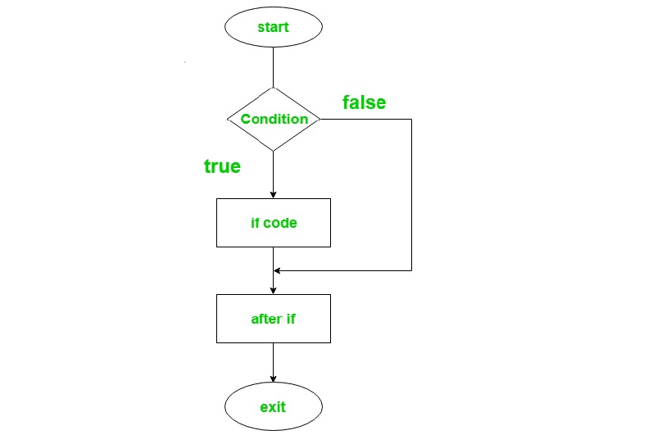
Flow chart of if statements:
Example of if statements:
fun main()
{
var a = 3
if(a > 0)
{
print(“This number is positive.”)
}
}

Slide 10
2.) if-else statement:
if-else statement contains two blocks of statements. ‘if’ statement is used to execute the block of code when the condition becomes true and ‘else’ statement is used to execute a block of code when the condition becomes false.
if(condition)
{
// code to run if condition is true
}
else
{
// code to run if condition is false
}
Notes:
When conducting research, it is easy to go to one source: Wikipedia. However, you need to include a variety of sources in your research. Consider the following sources:
Who can I interview to get more information on the topic?
Is the topic current and will it be relevant to my audience?
What articles, blogs, and magazines may have something related to my topic?
Is there a YouTube video on the topic? If so, what is it about?
What images can I find related to the topic?

Slide 11
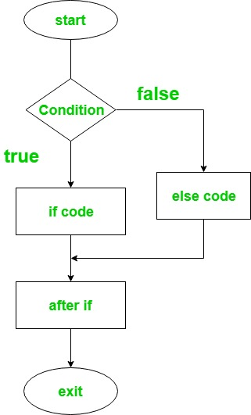
Flow chart of if-else statements:
Example of if statements:
fun main()
{
var a = 3
var b = 10
if(a > b)
{
print(“a is grater than b.”)
}
else
{
print(“b is grater than a.”)
}
}

Slide 12
Looping in Kotlin ?
A loop is a control flow statement that allows repeated execution of a block of code for a certain number of times or until a certain condition.
There are different types of looping in Kotlin:
While loop
Do-while loop
For loop
1.) While loop:
The while loop is used to execute a block of code while a condition is true. The while loop will execute the code block as long as the condition is true.
while (condition)
{
// code block }
Notes:
When conducting research, it is easy to go to one source: Wikipedia. However, you need to include a variety of sources in your research. Consider the following sources:
Who can I interview to get more information on the topic?
Is the topic current and will it be relevant to my audience?
What articles, blogs, and magazines may have something related to my topic?
Is there a YouTube video on the topic? If so, what is it about?
What images can I find related to the topic?

Slide 13
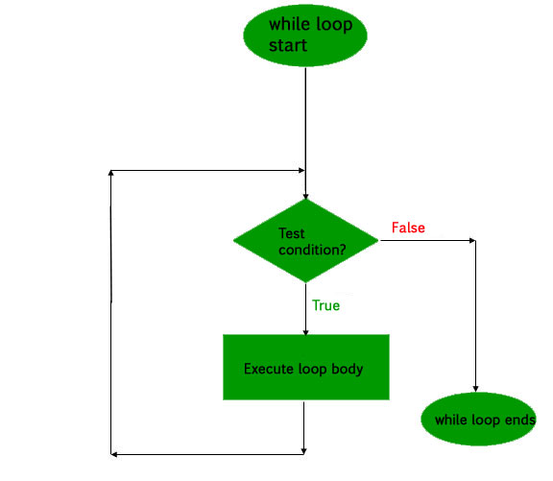
Flow chart of while loop:
Example of while loop:
(1.) using integer
fun main(args: Array<String>)
{
var num = 1
while(num <= 10)
{
println(num)
num++
}
}

Slide 14
Flow chart of while loop:
Example of while loop:
(2.) using string array
fun main(args: Array<String>)
{
var name = arrayof (“ram”, “shyam”, “mira”, “geeta”, “sita”)
var i = 0
while(i < name.size)
{
println(name[i])
i++
}
}

Slide 15
2.) Do-While loop:
Do-while loop is a control flow statement which executes a block of code at least once without checking the condition, and then repeatedly executes the block, or not, it totally depends upon a Boolean condition at the end of do-while block.
It contrast with the while loop because while loop executes the block only when condition becomes true but do- while loop executes the code first and then the expression or test condition is evaluated.
do-while loop working – First of the all the statements within the block is executed, and then the condition is evaluated. If the condition is true the block of code is executed again.
The process of execution of code block repeated as long as the expression evaluates to true. If the expression becomes false, the loop terminates and transfers control to the statement next to do-while loop.
It is also known as post-test loop because it checks the condition after the block is executed.
do
{
// code to run
} while(condition)
Notes:
When conducting research, it is easy to go to one source: Wikipedia. However, you need to include a variety of sources in your research. Consider the following sources:
Who can I interview to get more information on the topic?
Is the topic current and will it be relevant to my audience?
What articles, blogs, and magazines may have something related to my topic?
Is there a YouTube video on the topic? If so, what is it about?
What images can I find related to the topic?

Slide 16
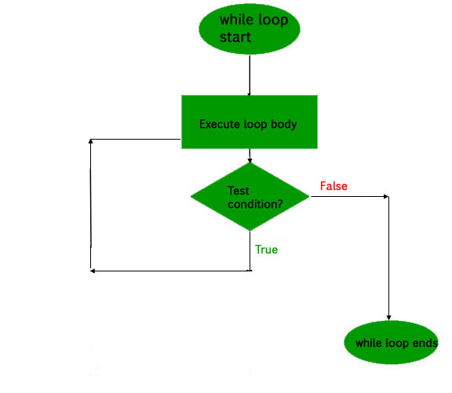
Flow chart of do-while loop:
Example of do-while loop:
fun main(args: Array<String>)
{
var num = 12
var i = 1
do
{
println(“$num * $i = “ +num * i)
i++
}while(i <= 10)
}

Slide 17
3.) for loop:
for loop is used to iterate a part of program several times. It iterates through arrays, ranges, collections, or anything that provides for iterate. Kotlin for loop is equivalent to the foreach loop in languages like C#.
The forEach loop in Kotlin is a function that allows you to iterate over a collection, such as a list, set, or map. It takes a lambda function as an argument, which is executed for each element in the collection. The forEach loop is a concise and expressive way to iterate over collections, and it is often used in Kotlin code.
for loop is used to iterate through the following because all of them provides iterator.
Range
Array
String
Collection
for(item in collection)
{
// code to execute
}
Notes:
When conducting research, it is easy to go to one source: Wikipedia. However, you need to include a variety of sources in your research. Consider the following sources:
Who can I interview to get more information on the topic?
Is the topic current and will it be relevant to my audience?
What articles, blogs, and magazines may have something related to my topic?
Is there a YouTube video on the topic? If so, what is it about?
What images can I find related to the topic?

Slide 18
Class & Funcation in Kotlin ?
classes and objects are used to represent objects in the real world. A class is a blueprint for creating objects (a particular data structure), providing initial values for state (member variables or fields), and implementations of behavior (member functions or methods).
An object is an instance of a class and has its own state and behavior. You can create multiple objects from the same class, each with its own unique state.
class is a blueprint for objects having similar properties. We need to define a class before creating an object and the class keyword is used to define a class. The class declaration consists of the class name, class header, and class body enclosed with curly braces.
Syntax of class : Syntax of funcation :
class className { // class header // property // member function }
fun funName { // fun header
//funcation data }
Notes:
When conducting research, it is easy to go to one source: Wikipedia. However, you need to include a variety of sources in your research. Consider the following sources:
Who can I interview to get more information on the topic?
Is the topic current and will it be relevant to my audience?
What articles, blogs, and magazines may have something related to my topic?
Is there a YouTube video on the topic? If so, what is it about?
What images can I find related to the topic?

Slide 19
Example of Class and funcation:
class Car {
var make : string = “”
var modal : string = “”
var year : Int = 0
fun getInfo() : string {
return “$make $modal, year $year”
}
}
fun main() {
val c = car()
c.make = “Toyota”
c.modal = “camry”
c.year = 2020
println(c.getInfo())
}
Notes:
When conducting research, it is easy to go to one source: Wikipedia. However, you need to include a variety of sources in your research. Consider the following sources:
Who can I interview to get more information on the topic?
Is the topic current and will it be relevant to my audience?
What articles, blogs, and magazines may have something related to my topic?
Is there a YouTube video on the topic? If so, what is it about?
What images can I find related to the topic?

Slide 20
By~ Ruzal Kathiriya
Let’s Learn about,
ANDROID STUDIO

Slide 21

What is Android ?
Android is an operating system (software package and linux based) for mobile devices such as tablet computers and smartphones.
Android offers a unified approach to application development for mobile devices which means developers need only develop for Android, and their applications should be able to run on different devices powered by Android.
The first beta version of the Android Software Development Kit (SDK) was released by Google in 2007 where as the first commercial version, Android 1.0, was released in September 2008.
On June 27, 2012, at the Google I/O conference, Google announced the next Android version, 4.1 Jelly Bean. Jelly Bean is an incremental update, with the primary aim of improving the user interface, both in terms of functionality and performance.
Notes:
When conducting research, it is easy to go to one source: Wikipedia. However, you need to include a variety of sources in your research. Consider the following sources:
Who can I interview to get more information on the topic?
Is the topic current and will it be relevant to my audience?
What articles, blogs, and magazines may have something related to my topic?
Is there a YouTube video on the topic? If so, what is it about?
What images can I find related to the topic?

Slide 22
Why Android?
Android
Open Source
Rich Development
Environment
Higher Success Ratio
Larger Developer and
Community Reach
Reduced Cost of
Development
Increased Marketing
Inter App Integration
Notes:
When conducting research, it is easy to go to one source: Wikipedia. However, you need to include a variety of sources in your research. Consider the following sources:
Who can I interview to get more information on the topic?
Is the topic current and will it be relevant to my audience?
What articles, blogs, and magazines may have something related to my topic?
Is there a YouTube video on the topic? If so, what is it about?
What images can I find related to the topic?

